Slide 1
MATH60025/MATH70025: 2024-2025
Lecture 1 : Brief Motivation
Computational Partial Differential
Equations

Slide 2
Common PDEs
Linear advection equation

Slide 3
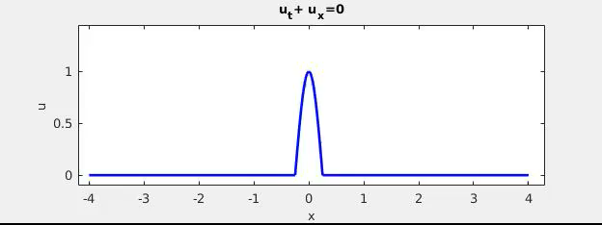
Common PDEs
Linear advection equation
+c

Slide 4
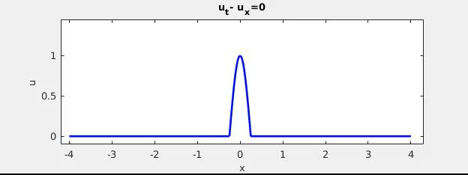
Common PDEs
Linear advection equation
+c
-c

Slide 5
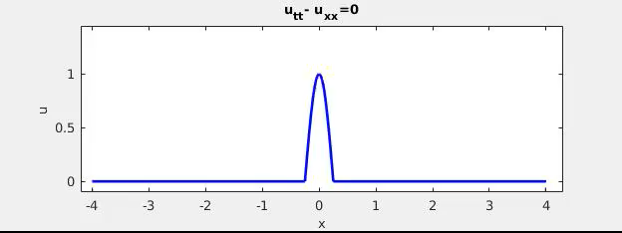
Common PDEs
Linear advection equation
Wave equation

Slide 6
Common PDEs
Linear advection equation
Wave equation

Slide 7
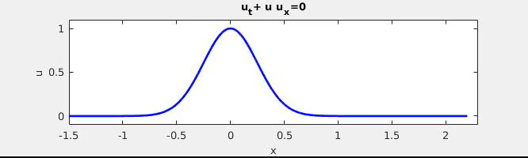
Common PDEs
Linear advection equation
Wave equation
Burgers equation

Slide 8
Common PDEs
Linear advection equation
Wave equation
Burgers equation
Viscous counterpart

Slide 9
Common PDEs
Linear advection equation
Wave equation
Burgers equation
Viscous counterpart
Heat or Diffusion equation

Slide 10
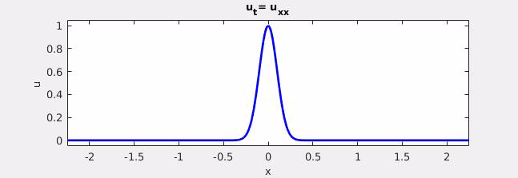
Common PDEs
Linear advection equation
Wave equation
Burgers equation
Viscous counterpart
Heat or Diffusion equation

Slide 11
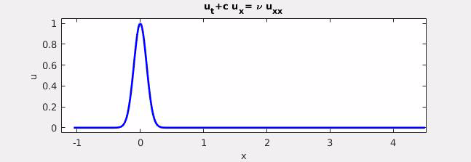
Common PDEs
Linear advection equation
Wave equation
Burgers equation
Viscous counterpart
Heat or Diffusion equation

Slide 12
Common PDEs
Linear advection equation
Wave equation
Burgers equation
Viscous counterpart
Heat or Diffusion equation
2D
3D

Slide 13
Common PDEs
Linear advection equation
Wave equation
Burgers equation
Viscous counterpart
Heat or Diffusion equation
2D
3D
Laplace equation

Slide 14
Common PDEs
Linear advection equation
Wave equation
Burgers equation
Viscous counterpart
Heat or Diffusion equation
2D
3D
Laplace equation
Poisson's equation

Slide 15
Common PDEs
Linear advection equation
Wave equation
Burgers equation
Viscous counterpart
Heat or Diffusion equation
2D
3D
Fokker-Planck equation for probability density p(x,t)
SDEs, Brownian motion etc.

Slide 16
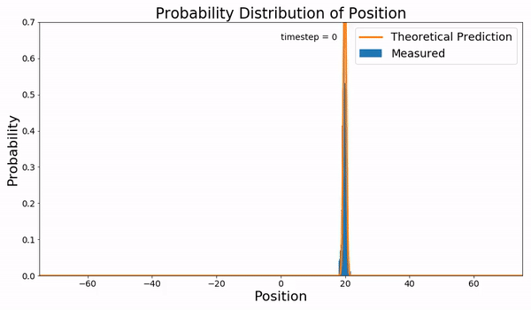
Fokker-Planck equation for probability density p(x,t)
Brownian Dynamics simulation for particles in 1-D linear potential compared with the solution of the Fokker-Planck equation.
Diffusion eqn.
Advection eqn.
https://commons.wikimedia.org/wiki/File:Linear_Potential2.gif

Slide 17
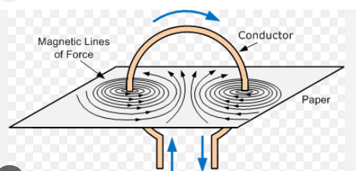
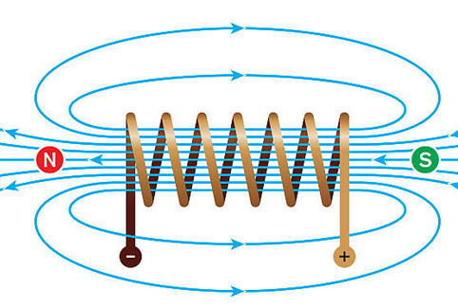
Maxwells equations: Electro-magnetism
Common PDEs
Describes evolution of the electric field E and magnetic field B in the presence of an electric charge density and current J.

Slide 18
Black-Scholes Model : Finance
Common PDEs
Diffusion term
Advection term
the price of a European call or put option over time
Where V is the price of the option.
Function of two variables: the stock price S and time t.
r is the risk-free interest rate
σ is the volatility.

Slide 19
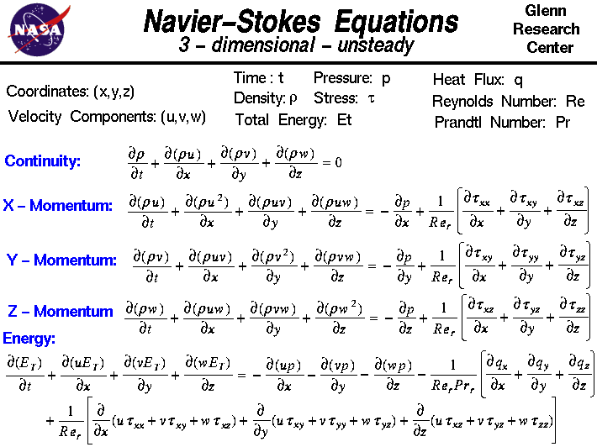
Fluids

Slide 20
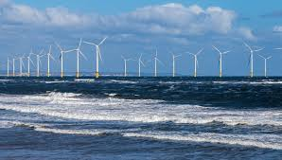
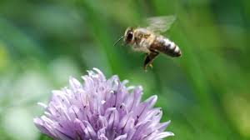
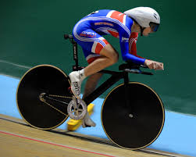
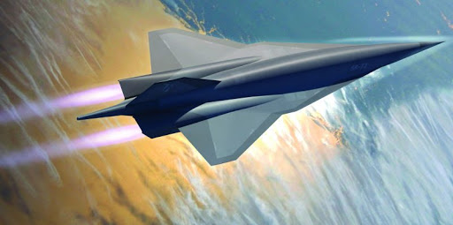
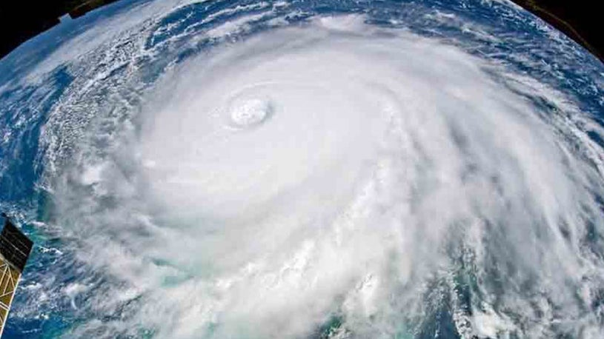
Navier-Stokes Equations in Action

Slide 21
Consider Laplace equation for u(x,y) in a rectangle:
y
Using separation of variables and Fourier series, you can show that solution is:
x

Slide 22
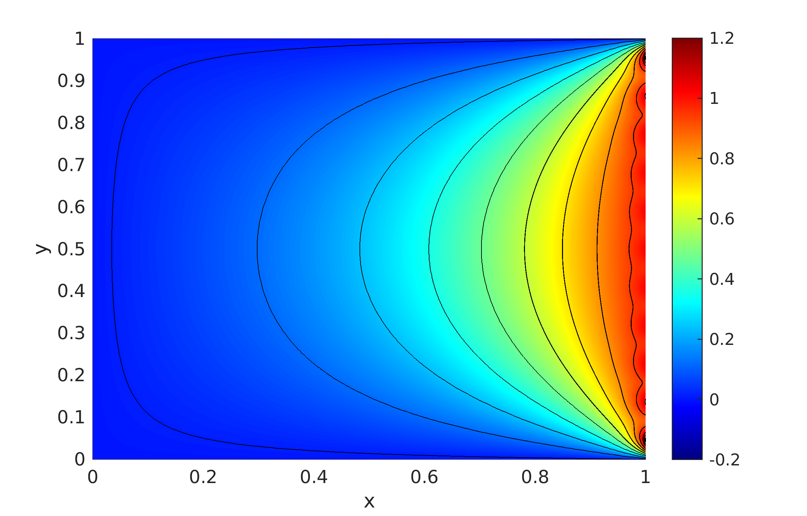
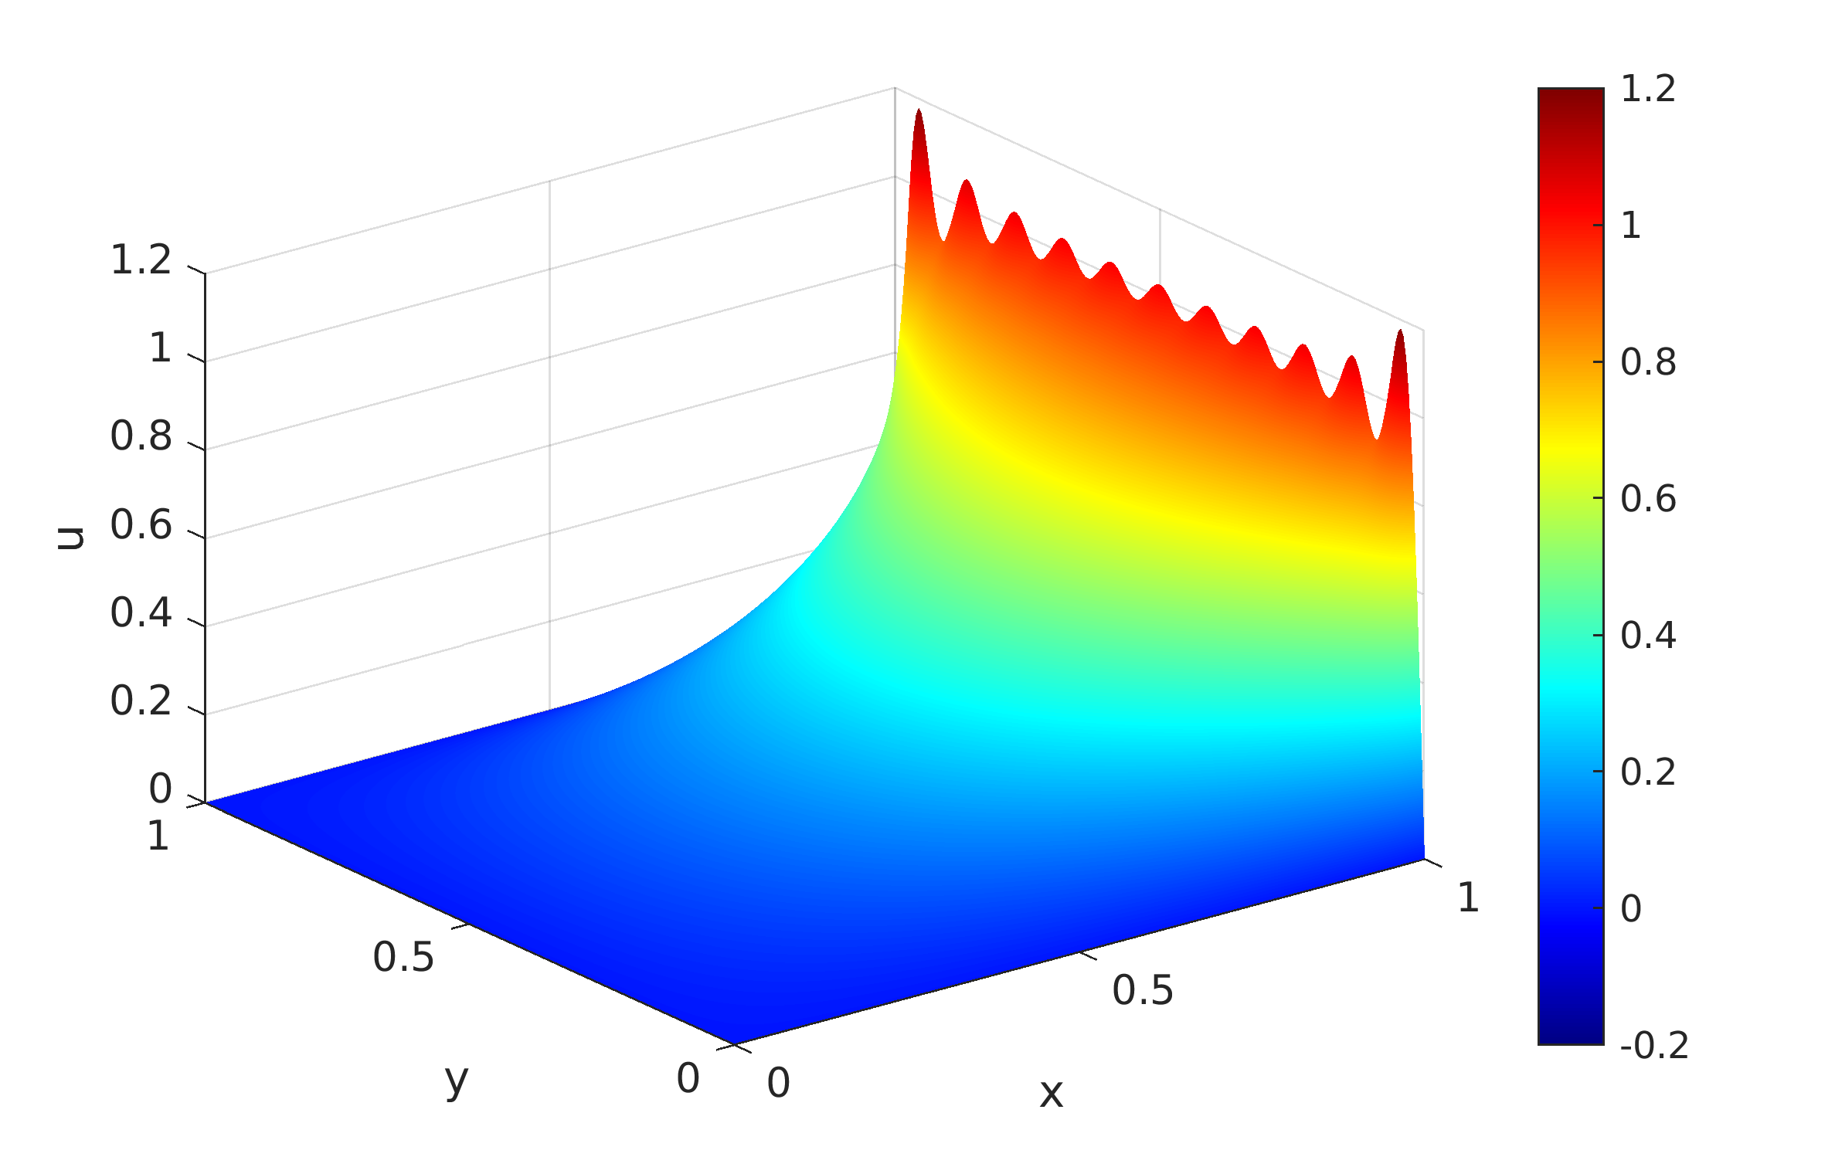
n = Nmax = 21 Upper limit in summation
2D view : 3D surface plot :

Slide 23
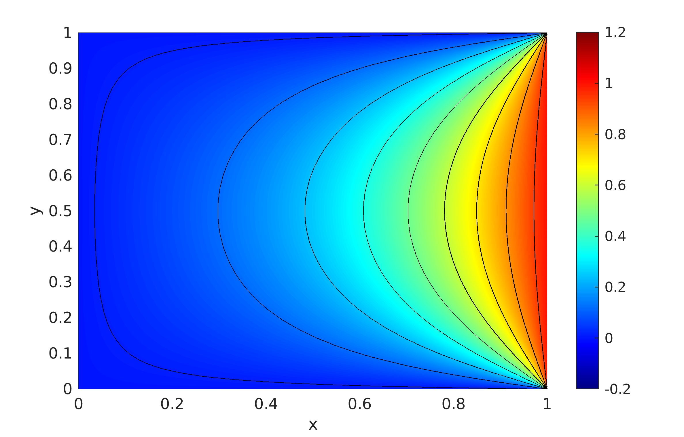
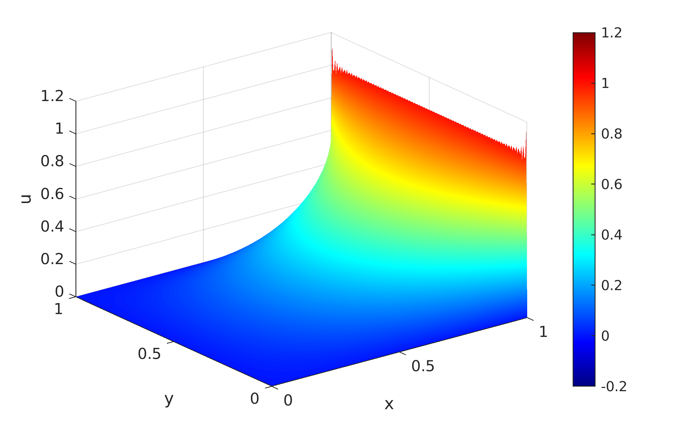
n = Nmax = 161 Upper limit in summation
2D view : 3D surface plot :

Slide 24
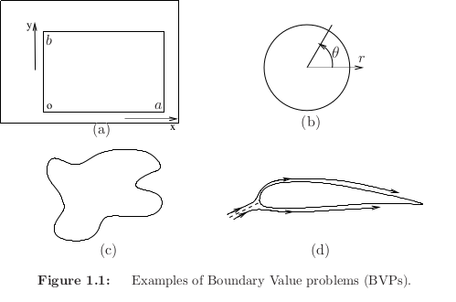
Examples of boundary value problems :
y
x

Slide 25
Examples of boundary value problems :
y
x

Slide 26
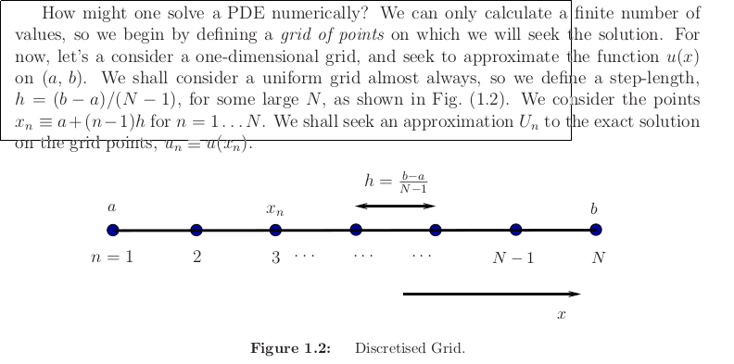
Finite Differences: Define a grid… consider a 1D-problem for the moment

Slide 27
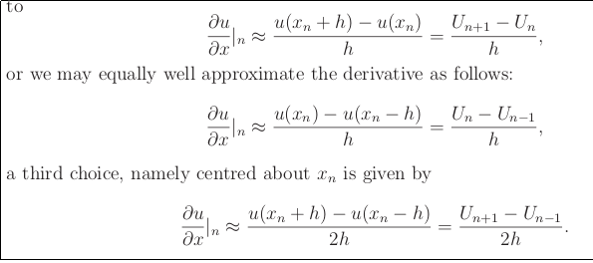
Let us take a Simple approach…

Slide 28
Our first finite difference method : consider the ode

Slide 29
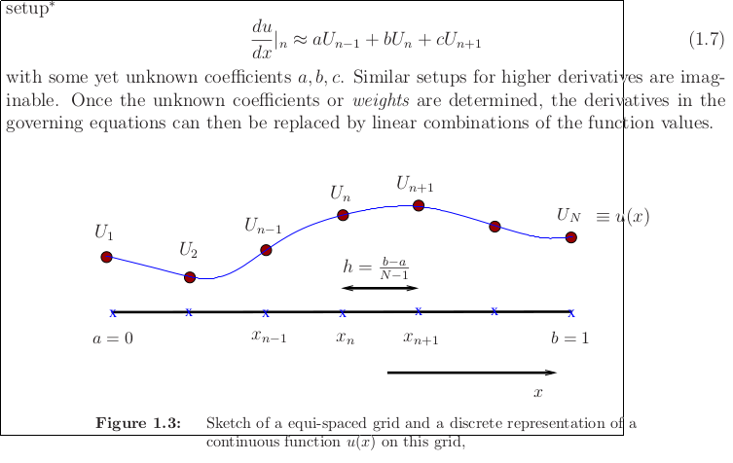
Our first finite difference method : consider the ode

Slide 30
Homework:
Solve on your computer and compare your numerical solution with the exact solution.

